Slide 1
A Review of Modern Fashion Recommender System
Nirajan Bekoju

Slide 2
How Fashion Recommender differ from Other?
Precise and detailed product information may not always be available
In addition to product to product relationship, product to user relationship like fit i.e size of the product must be taken into account.
Primary reason for returned of the fashion product is due to the size(fit issues).
Different domains or techniques like 3D scanning and customer reported measurement can be leveraged for personalized recommendation.
Research on alternative that allow a customer to visualize the appearance and fit of clothes using augmented and virtual reality.
Moreover, custom design of the product with right appearance and fit is also an effective measure. Eg: Amazon with the Made for you Custom T-shirt.

Slide 3
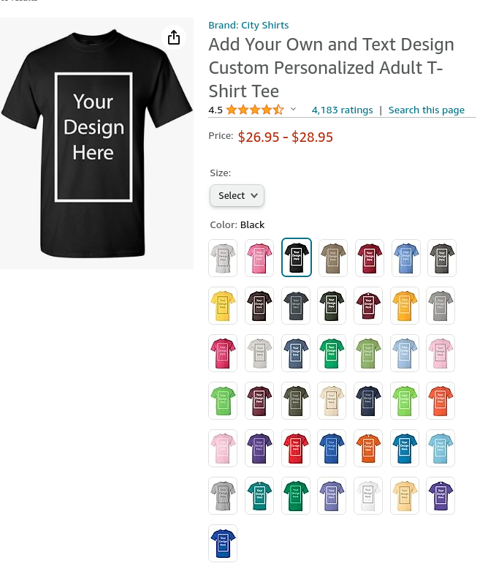

Slide 4
Challenges in Fashion Recommendation

Slide 5
C1: Fashion Item Representation
Traditional Recommender System(Content and Collaborative-based) have difficulties in the fashion domain due to sparsity of purchase data or the insufficient detail about the visual appearance of the product in category names.
More recent literature has leveraged models that capture the rich representation of fashion items through product images, text descriptions or customer reviews or videos.

Slide 6
Fashion Item Compatibility
Training a model that is able to predict if two fashion items go together or directly combine several products into an outfit is a challenging task.

Slide 7
Personalization and Fit
The best fashion product to recommend depends on factors such as the location where the outfit will be used, the season or occasion or the cultural and social background of the customer.
A challenging task is how to discover and integrate these disparate factors.
Prediction of what size of clothes will be more comfortable to wear i.e body shape can influence the style choices.

Slide 8
Interpretability and Explanation
Most of existing fashion recommender systems in the literature focus on improving predictive performance, treating the model as a black box.
However, deploying accountable and interpretable systems able to explain their recommendations can foster user loyalty in the long term and improve the shopping experience.

Slide 9
Discovering Trends
Being able to forecast consumer preferences is valuable for fashion designer and retailers in order to optimize product-to-market fit, logistics, and advertising.

